Slide 1
Hyperbolic Geometry
By Xinyu Cheng, undergraduate student from Department of Math, CUHK
Supervised by Professor WU Zhongtao

Slide 2
Part I Axioms of Hyperbolic Geometry
Axiom 1: We can draw a unique line segment between any two points.
Axiom 2: Any line segment may be continued indefinitely.
Axiom 3: A circle of any radius and any center can be drawn.
Axiom 4: Any two right angles are congruent.
Axiom 6: Given any two points P and Q, there exists an isometry f such that f(P) = Q. (translation)
Axiom 7: Given a point P and any two points Q and R which are equidistant from P, there exists an isometry which fixes P and sends Q to R. (rotation)
Axiom 8: Given any line l, there exists a map which fixes every point in l and fixes no other points. (reflection)
Axiom 5H: Given any line l and any point P not on l, there exist two distinct lines l1 and l2 through P which do not intersect l. (parallels)

Slide 3
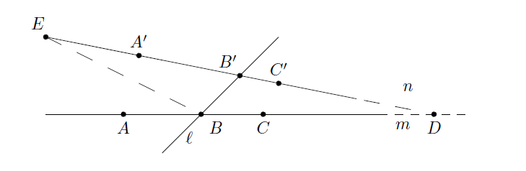
Thm 1: (Alternate Interior Angle Thm)
Alternate interior angle congruent implies parallel.
Given ∠EB’B= ∠DBB’

Slide 4
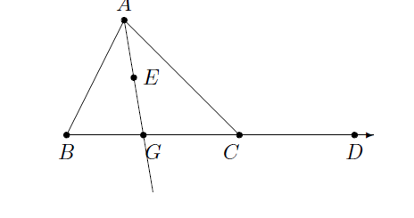
Thm 2: weak exterior angle thm
An exterior angle of a triangle is greater than either remote interior angle.
Claim: ∠ACD＞∠BAC (or ABC
By symmetry)

Slide 5
Some corollaries
i) Every angle has a unique bisector.
ii) Every segment has a unique perpendicular bisector.
iii)In a triangle △ ABC the greater angle lies opposite the greater side and the greater side lies opposite the greater angle; i.e., AB > BC if and only if ∠ C > ∠ A. (mentioned later by using hyperbolic law of sine)

Slide 6
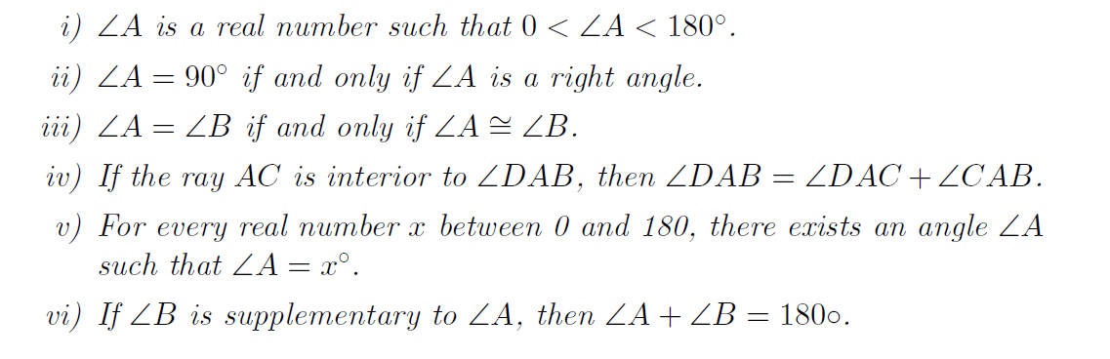
Then we can define the degree measure to each angle

Slide 7
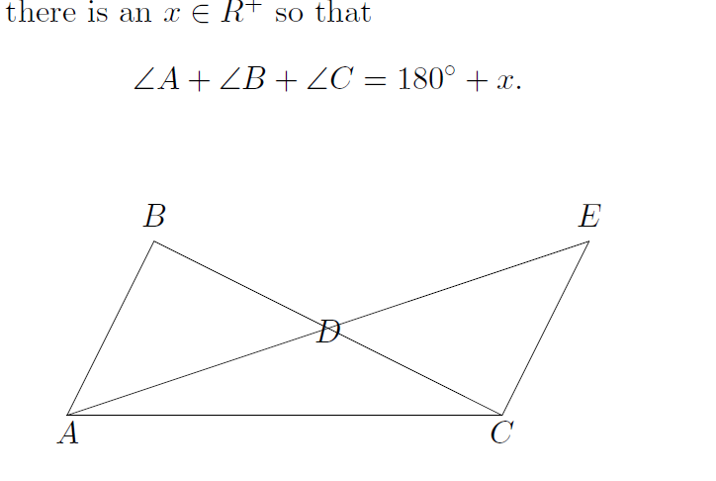
Thm 3: (Saccheri-Lengendre)
The sum of the degree measures of the three angles in any triangle is less than or equal to 180°：∠A + ∠ B + ∠ C ≤180°:

Slide 8

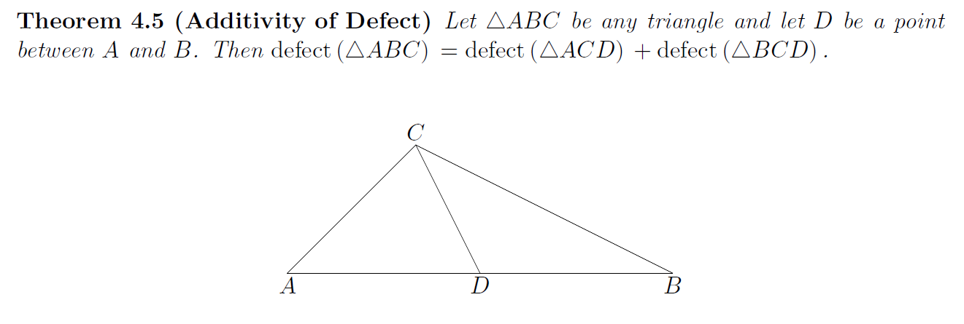
Definition：

Slide 9
Thm 5
If there exists a triangle of defect 0, then a rectangle exists. If a rectangle exists, then every triangle has defect 0.
This is a powerful theorem!(why)
Steps to prove:
1. Construct a right triangle having defect 0.
2. From a right triangle of defect 0, construct a rectangle.
3. From one rectangle, construct arbitrarily large rectangles.
4. Prove that all right triangles have defect 0.
5. If every right triangle has defect 0, then every triangle has defect 0.

Slide 10
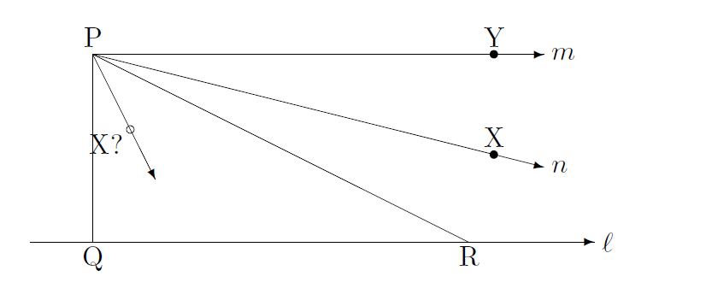
Thm 6 (property of hyperbolic geometry)
There exists a triangle whose angle sum is less than 180°.

Slide 11
Then we have an idea to construct another parallel!

Slide 12
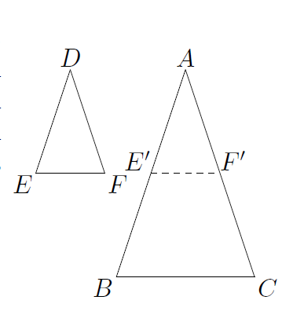
Thm 7(AAA Criterion)
In H^2 if ∠A = ∠ D, ∠ B = ∠ E, and ∠ C = ∠ F, then △ABC ≌ △ DEF. That is, if two triangles are similar, then they are congruent.

Slide 13
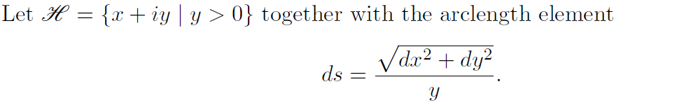
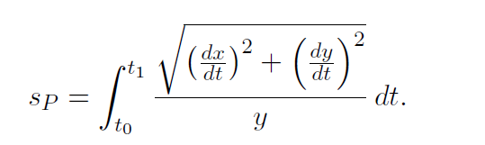
Part 2 2.1Poincaré Half-plane Model
So the Poincare arclength is

Slide 14
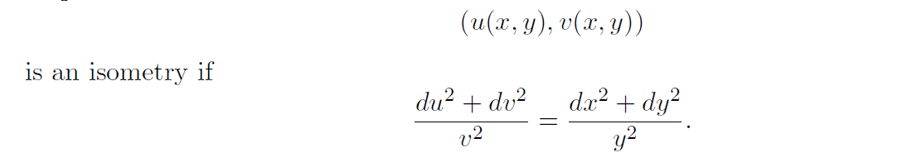
Isometries

Slide 15


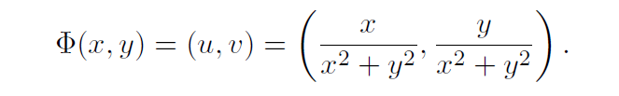
3 types of Isometries we will consider
Horizontal translation:
Reflection by a verticle line:
Inversion in the unit circle:

Slide 16
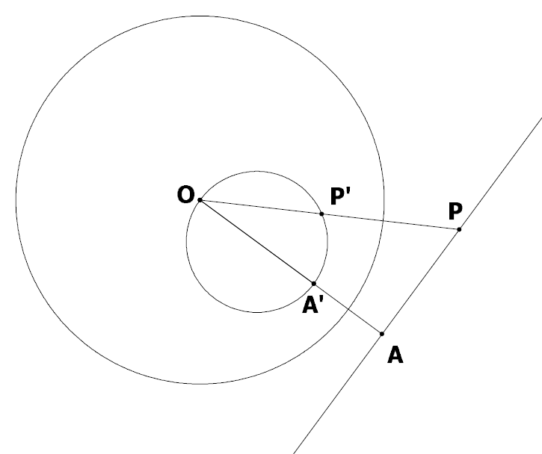
Lemma 2.1
The image of a line which does not go through the origin O under inversion in the unit circle is a circle which goes through the origin O.

Slide 17
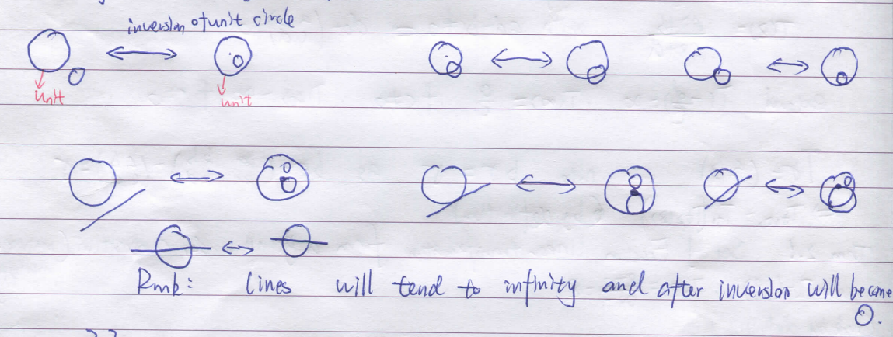
Similarly, we could show other circles and lines under inversion are also lines or circles.

Slide 18
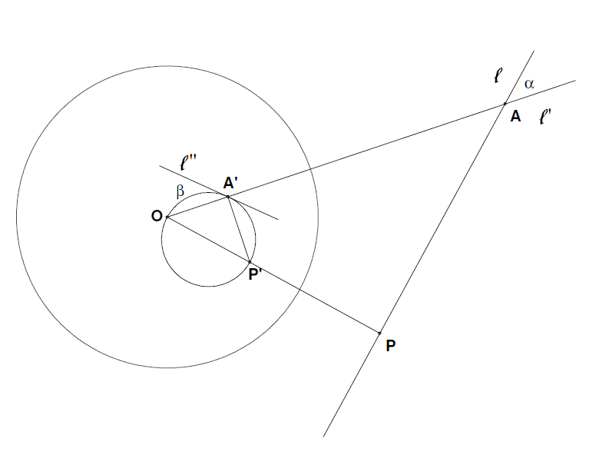
Lemma 2.2 Inversion Preserve Angles
We will just consider the case of an angle α created by the intersection of a line l not intersecting the unit circle, and a line l’ through O.

Slide 19
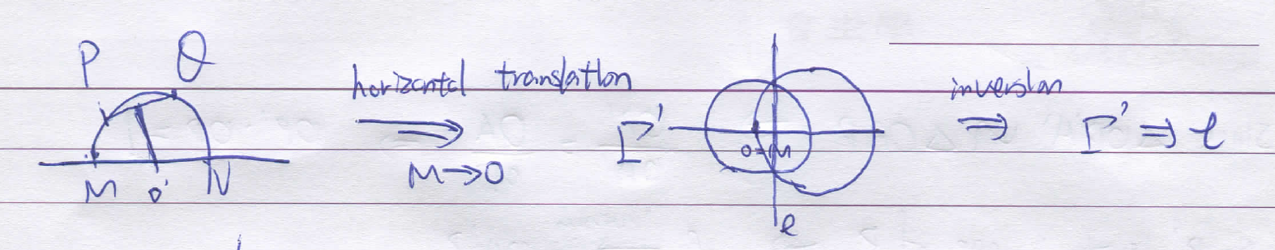
Lemma 2.3 (Lines in Poincare Half-plane Model)
Lines in the Poincare upper half plane model are (Euclidean) lines and (Euclidean) half circles that are perpendicular to the x-axis.

Slide 20

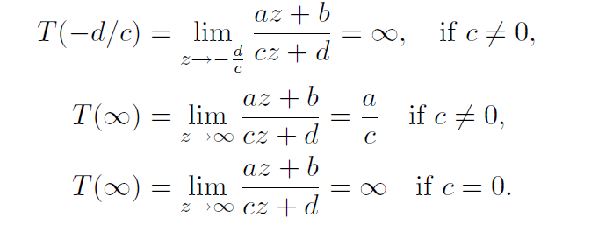
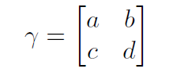
2.2Fractional Linear Transformations

Slide 21
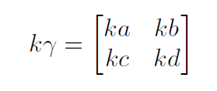
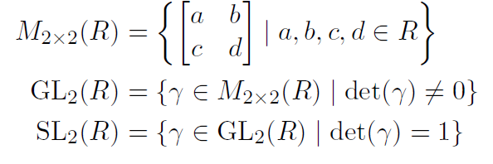
Note: Kγ=γ
Thm 2.1 The set of fractional linear transformations forms a group under composition (matrix-multiplication).
Moreover we could define PSL2(R) which identifies Kγ=γ

Slide 22

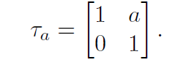

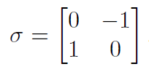
Horizontal translation
Inversion in the unit circle followed by reflection through x = 0

Slide 23
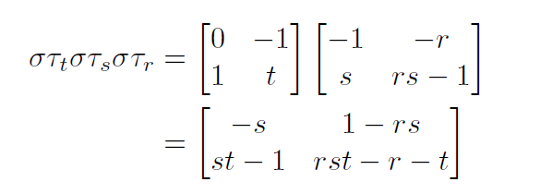
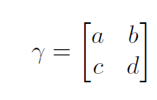
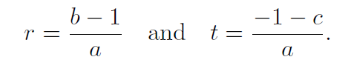
Thm 2.2
Reason:

Slide 24
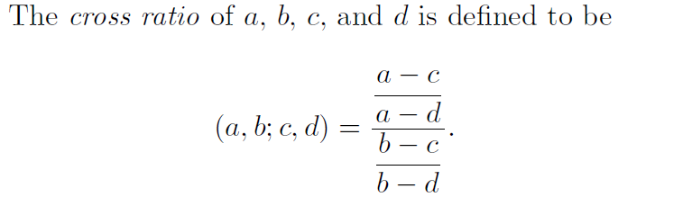
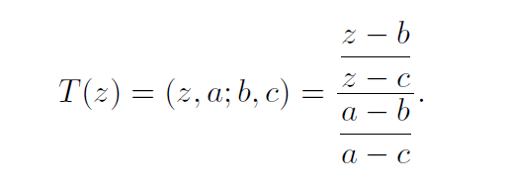

2.3Cross Ratio:

Slide 25
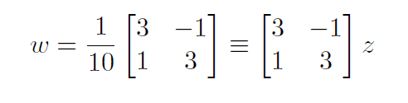
Example:
If T sends i to i, ∞ to 3, 0 to-1/3, what is T?
Set( w,i; 3,-1/3)=(z,i; ∞, 0)
Then we get

Slide 26
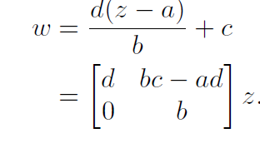

2.4Let’s consider Translations( not necessarily the horizontal case)
Let P = a + bi and Q = c + di.
(w, c+di; c ,∞)=(z, a + bi ; a, ∞ )
here we send the infinity to infinity, a to c.
Does it have fixed point? No in Half-Plane Model !

Slide 27

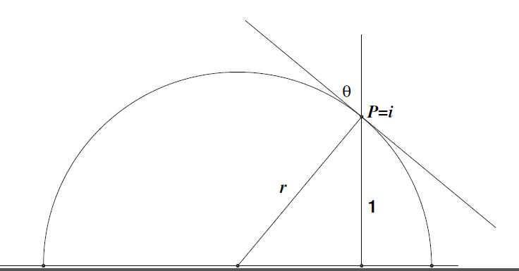
2.5Rotation:
Let this circle intersect the x-axis at points M and N
Just need
M
N

Slide 28
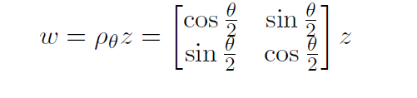
Similar to Euclidean Case!

Slide 29

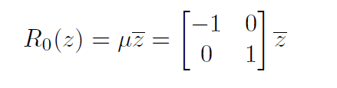
2.6Reflection
We did see that the reflection through the imaginary axis is given by
then

Slide 30




Now, to reflect through the line l in H , first use the appropriate isometry, γ1 to move the line l to the imaginary axis, then reflect and move the imaginary axis back to l:
Note that μ^2 = 1 and detμ = -1
Hence every reflection can be written in the form:
for some

Slide 31
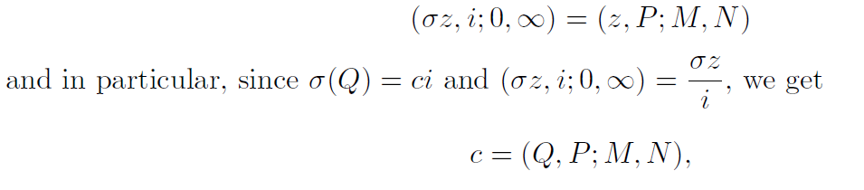

2.7Distance and length
P and Q don't lie on a vertical line segment. We just rotate, then this is the transformation that sends P to i, M to 0 and N to ∞. Since the image of Q will lie on this line, Q is sent to some point 0+ci for some
c. Then

Slide 32
2.8 Area of triangles
Doubly asymptotic triangle: 2 vertices lie in infinity
Triply asymptotic triangle: all 3 vertices lie in infinity

Slide 33


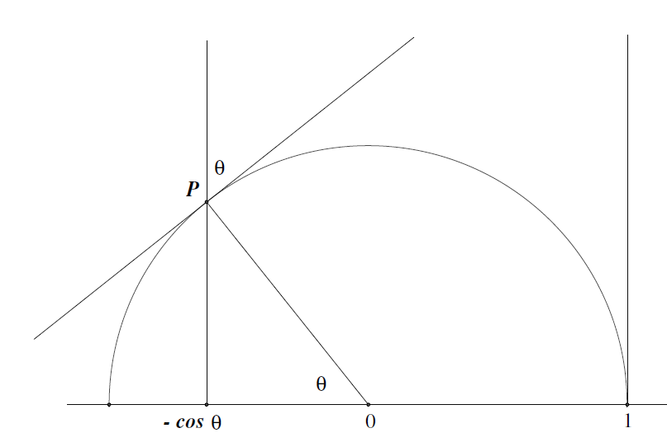

Lemma 2.4
The area of a doubly asymptotic triangle with points ­
at infinity.
Then the area is

Slide 34
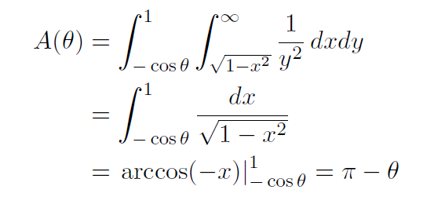
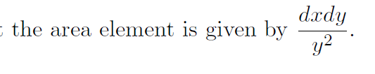
Since similar triangle has same area

Slide 35
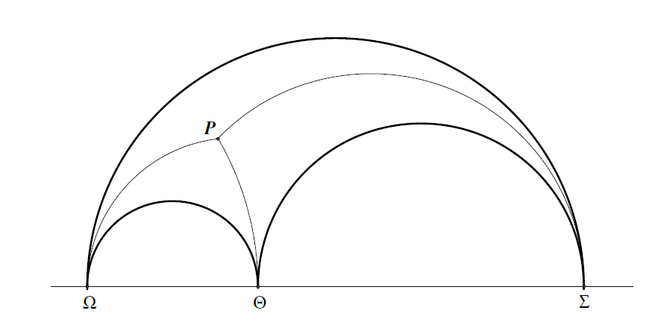
Corollary 2.1
Area of Triply asymptotic triangle is π.

Slide 36
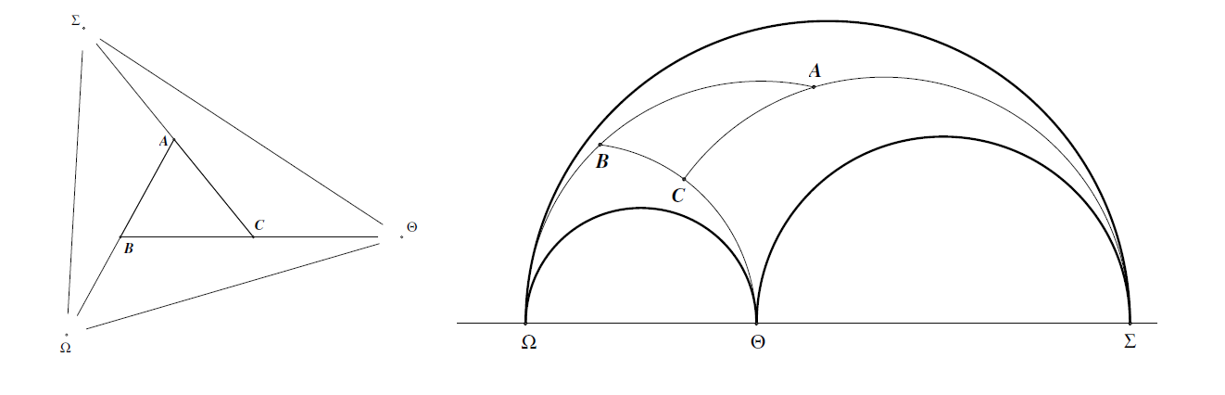
Corollary 2.2
Area of finite △ABC=π-(A+B+C)

Slide 37
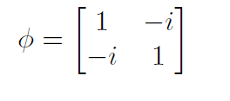
Part 3 Poincare Disk Model
Use the transform:
This map sends 0 to -i, 1 to 1, and ∞ to i.
Send upper half-plane to the interior of unit disk, denoted by D
RMK: Lines in D are circle arcs that are orthogonal to unit circle or diameters.

Slide 38
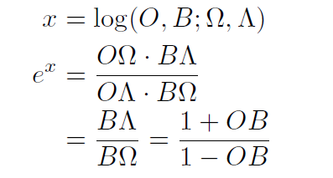
Lemma 3.1
If dp(O,B)=x, then d(O,B)=tanh(x/2)

Slide 39
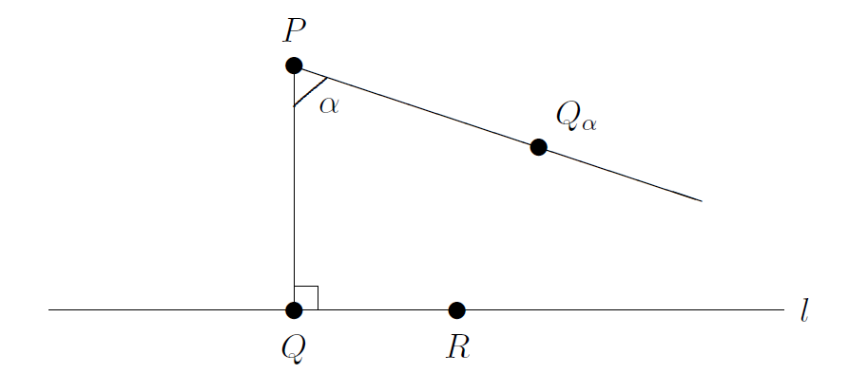
Angle of parallelism
the angle of parallelism φ, also known as Π(p), is the angle at one vertex of a right hyperbolic triangle that has two asymptotic parallel sides( intersect at infinity)

Slide 40
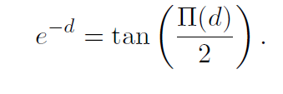
Thm 3.1 (Bolyai-Lobachevsky Theorem)
In the Poincare model of hyperbolic geometry the angle of parallelism satisfies the equation

Slide 41
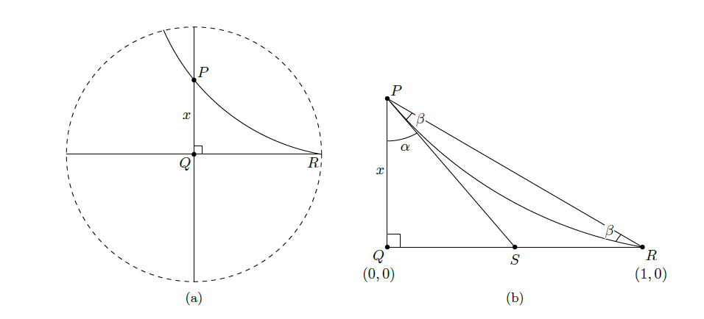

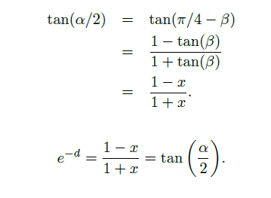

Slide 42
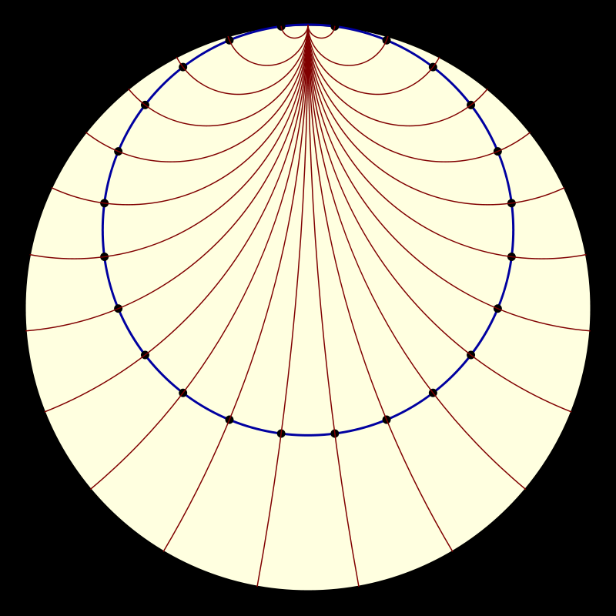
Hypercycles and Horocycles
Horocycle:
“Correspondence”: two lines intersect at infinity in the same direction Ω.
Then P and Q( on different lines) are correspondent if ∠PQΩ=∠QPΩ
The set consisting of P and all such points Q is called a horocycle

Slide 43
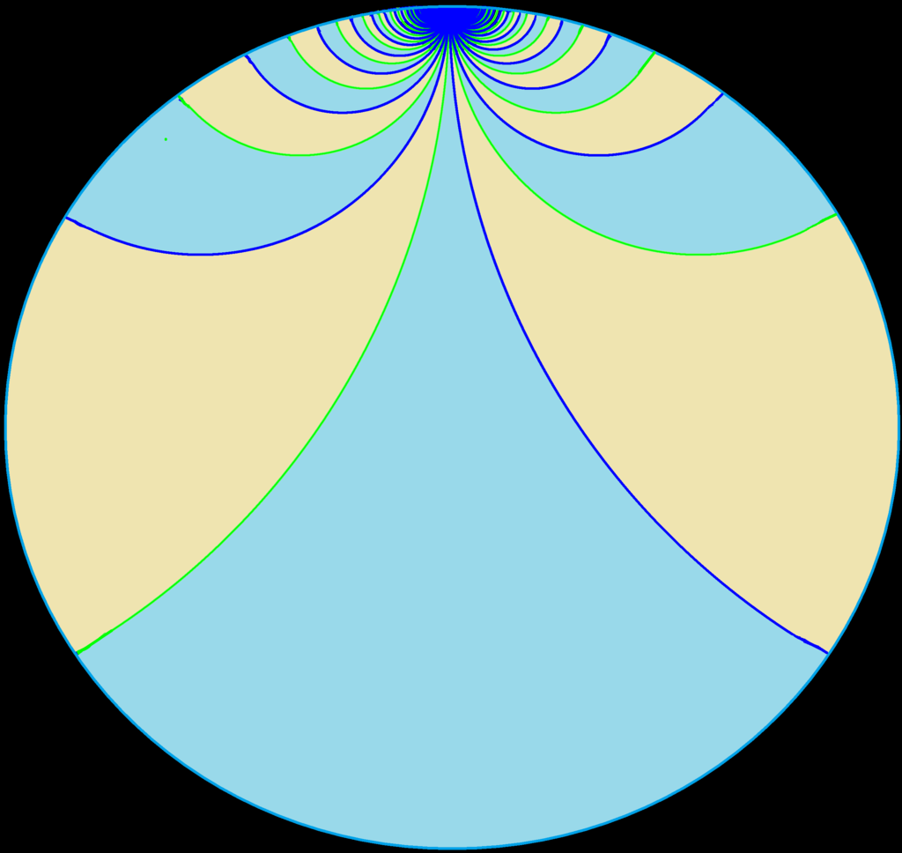
Hypercycle:
Given a line l and a point P not on l, consider the set of all points Q on one side of l so that the perpendicular distance from Q to l is the same as the perpendicular distance from P to l.

Slide 44
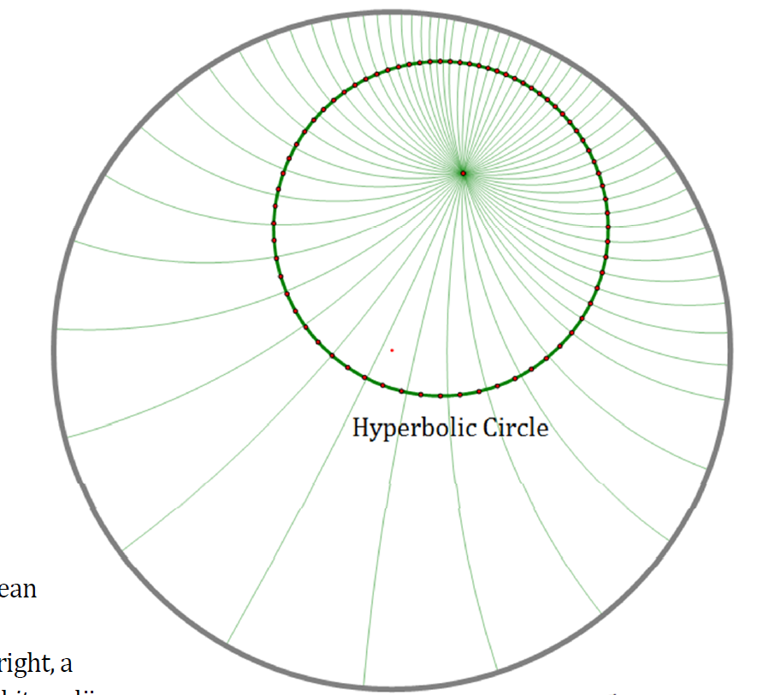
In Poincare Disk Model (4 types of cycles)
Hyperbolic circle: a circle contained entirely in the unit disk

Slide 45
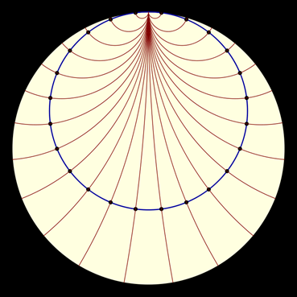
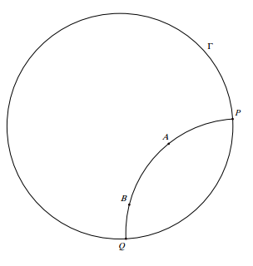
Horocycle: circle tangent to unit disk
Lines: circles orthogonal to unit disk or diameters
Otherwise Hypercycles

Slide 46
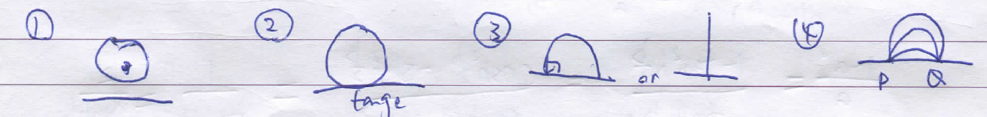
In upper half-plane model
They are respectively circle, horocycle, line, hypercycle

Slide 47
Part 4 4.1 some geometric laws
Rt△ABC, ∠C=90°
Thm 4.1 Pythagoras’ Theorem
cosh(c)=cosh(a)*cosh(b)
Thm 4.2 Lobachevskii’s Formula
tan(A)=tanh(a)/sinh(b)
sin(A)=sinh(a)/sinh(c)
cos(A)=tanh(b)/tanh(c)

Slide 48
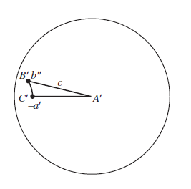

Ideas:
Let C=0, B=ib’,A=a’
Consider M(z)=(z-a’)/(1-a’z)
Then we send A to O, B to b’’=(ib’-a’)/(1-a’ib’), C to-a’
Then we use distance formula to calculate

Slide 49


Thm 4.3(Hyperbolic law of sines)
Hint:
By Thm 4.2
sinh(h) = sin(A) sinh(c)
sinh(h) = sin(C) sinh(a).

Slide 50
Thm 4.4(Hyperbolic law of cosines)
1st law:
cosh(a) = cosh(b) cosh(c) − sinh(b) sinh(c) cos(A).
2nd law:
cos(B) = −cos(A) cos(C) + sin(A) sin(C) cosh(b).

Slide 51




4.2 Circumference and Area of a Circle
Use similar method in Euclidean Geometry (use polygon)
By Thm 4.2

Slide 52
C= 2πsinh(r)
Similarly,
Area= 4πsinh^2(r/2)

Slide 53

4.3 Saccheri Quadrilaterals& Lambert quadrilaterals
Let S be a convex quadrilateral in which two adjacent angles are right angles.
The segment joining these two vertices is called the base. The side opposite the base is the summit and the other two sides are called the sides. If the sides are congruent to one another then this is called a Saccheri quadrilateral. The angles containing the summit are called the summit angles.

Slide 54


Properties:
Hint use triangle congruence to show

Slide 55

Lambert Quadrilaterals
a convex quadrilateral three of whose angles are right angles is called a Lambert quadrilateral.
Properties: The side adjacent to the acute angle of a Lambert quadrilateral is greater than its opposite side.
Use exterior angle thm to prove

Slide 56

4.4 Constructing coordinate system
Use cos(θ)=sin(90- θ)=sinh(a)/sinh(d)
and laws of cosine

Slide 57
Then in Lambert quadrilateral, if c is the length of a side adjacent to the acute angle, a is the length of the other side adjacent to the acute angle, and b is the length of the opposite side, then
sinh(c)= cosh(a)*sinh(b)

Slide 58

Then we could construct coordinate system
Sin(θ)=cos(90-θ)=tanh(v)/tanh(r);
cos(θ)=tanh(u)/tanh(r);
Then tanh^2(u)+tanh^2(v)=tanh^2(r)

Slide 59

We also set
x = tanh u; y = tanh v
T = cosh u coshw; X = xT; Y = yT;

Slide 60

The ordered pair {OX;OY } is called a frame with axes OX and OY . With respect to this frame, we say the point P has

Slide 61


Slide 62
Thanks for watching!

